Slide 1
Software Engineering
Dr. Fatma ElSayed
Dr. Ahmed Yousry
Computer Science Department

Slide 2
Course Information
Contents
Introduction to Software Engineering
Software Processes
Requirements Engineering
System Modelling Part1
System Modelling Part2
System Architecture
Software Testing Strategies
Software Testing Techniques
Technical Metrics for Software

Slide 3
Course Information
Contents
Introduction to Software Engineering
Software Processes
Requirements Engineering
System Modelling Part1
System Modelling Part2
System Architecture
Software Testing Strategies
Software Testing Techniques
Technical Metrics for Software

Slide 4
Activity Diagram

Slide 5
Activity Diagrams
Activity diagram gives a simplified, step-by-step view of what the system does during an operation or process (Process perspective).
This diagram much like the flowcharts . It shows steps (called, activities), showing their sequences, and where activities can be carried out in parallel as well as decision points and branches.
It can also be extended to show which person is responsible for which activity.
An activity could be a task that a person or a computer might perform.

Slide 6
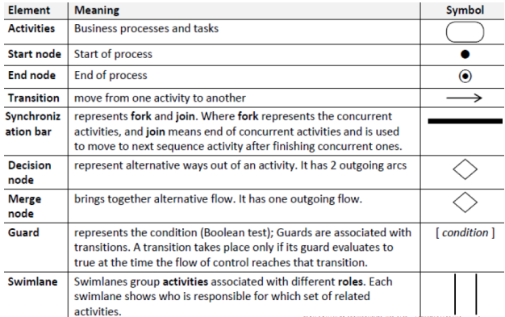
Activity Diagrams: Symbols and Elements

Slide 7
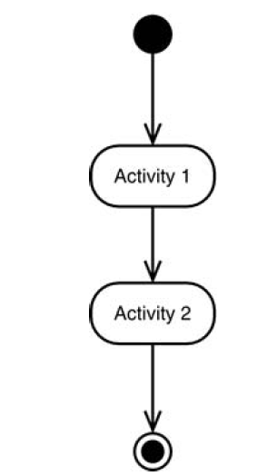
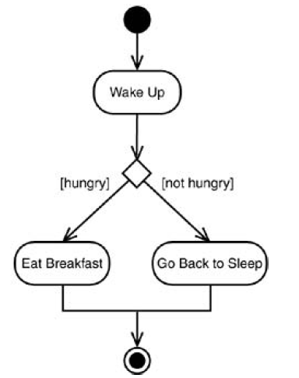
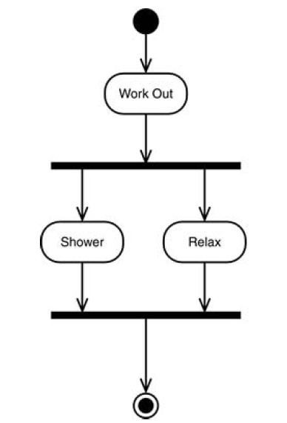
Activity Diagrams: Symbols and Elements
Decisions
Concurrent Paths

Slide 8
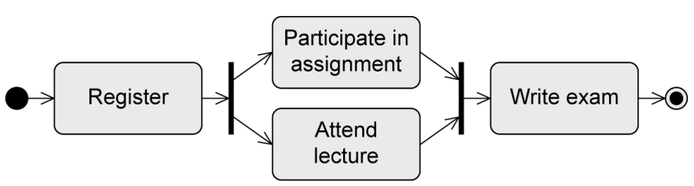
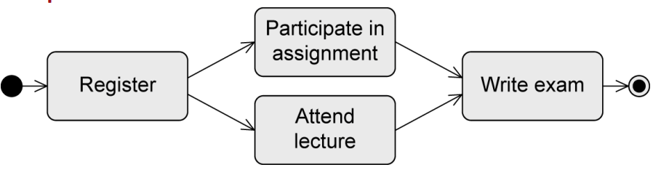
Activity Diagrams: Symbols and Elements
.. equivalent to

Slide 9
Activity Diagrams: Example (1)
Suppose, after a hard day’s work, you decide to make yourself a hot drink. What do you do to achieve that goal? What are the actions and how do you organize them?
We start with a process called make hot drink. At the center of this task is boiling water in a kettle.
Usually, there are two steps.
Fill the kettle with water.
Boil the water.
To begin with, we will consider instant coffee (as a particular scenario). Finally, you need a cup to drink from.

Slide 10
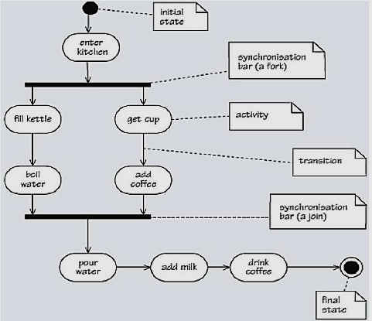
Activity Diagrams: Example (1)
Figure 1

Slide 11
Activity Diagrams: Example (1)
The basic elements of an activity diagram are activities and transitions. The completion of an activity triggers an outgoing transition. Similarly, once the incoming transition has been triggered an activity may commence.
There are two predefined activities, start and stop, which is represented as filled circles, a diagram may include more than one stop node if it makes it clearer.
The Figure shows two synchronization bars, denoted by thick horizontal lines, the upper one denotes a fork and the lower one a join. The upper bar allows for separate activities to be carried out in parallel, so between the two synchronization bars the two separate strands can be performed concurrently.
In UML, a note (with annotation) is shown as a rectangle with the top right-hand corner folded down.
A dashed line is used to attach the note to the model element to which it refers.

Slide 12
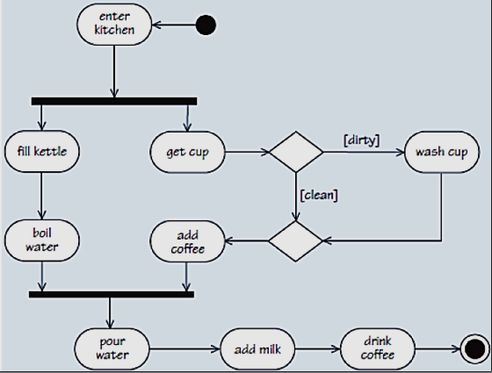
Activity Diagrams: Example (1)
Redraw the activity diagram of preparing a cup coffee so that
It allows to check if cup is clean continue the process, if not wash the cup.
Figure 2

Slide 13
Activity Diagrams: Example (1)
Each of the transitions leaving the first decision diamond has a guard to determine which path should be taken under a given condition.
One outgoing transition should always be taken – this means that exactly one of the relevant guards must always evaluate to true.
A diamond shape is also used as a merge node, which brings together alternative mutually exclusive flows, as shown in figure 2.
A merge node will be reached only by one of the alternative flows and has a single outgoing flow.
This is enforced by ‘decision’ and ‘merge’ nodes for alternative outgoing and incoming transitions, and by synchronization bars for concurrent outgoing (fork) and incoming (join) transitions

Slide 14
Activity Diagrams: Example (2)
Consider the lending process from a library :
A typical lending library keeps a stock of books for the use of its members. Each member can look on the library shelves to select a copy to borrow. Then take out a number of books, up to a certain limit. After a given period of time, the library expects members to return the books that they have on loan.
When borrowing books, a member is expected to wait in queue, then to hand their chosen books to the librarian, who records each new loan before issuing the books to the member. After that the librarian will prepare for next member in the queue.

Slide 15
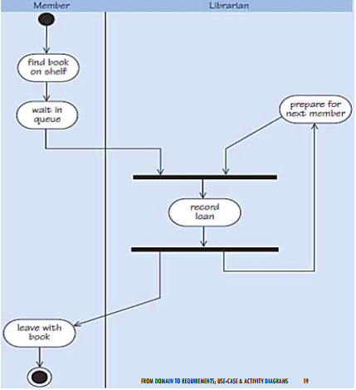
Activity Diagrams: Example (2)
An activity diagram of borrowing a copy of a book from the library.
Figure 3

Slide 16
Activity Diagrams: Example (2)
Swim-lanes group activities associated with different roles.
The swim-lanes show the role that is responsible for each activity.
When you are modelling a workflow that involves more than one role, it is possible to identify which role is responsible for a particular activity.
An activity diagram can help identify the stages at which each role requires some interaction with the process.
In figure 3: The left-hand swim-lane contains the activities that a library member performs when borrowing a book, while the right-hand swim-lane shows the library’s self-service system workflow for the same process (‘issue copy of book’).

Slide 17
Activity Diagrams: Swim lanes
The activity diagram adds the dimension of visualizing roles.
To do that, you separate the diagram into parallel segments.
Each segment shows the name of a role at the top and presents the activities of each role.
Transitions can take place from one segment to another.

Slide 18
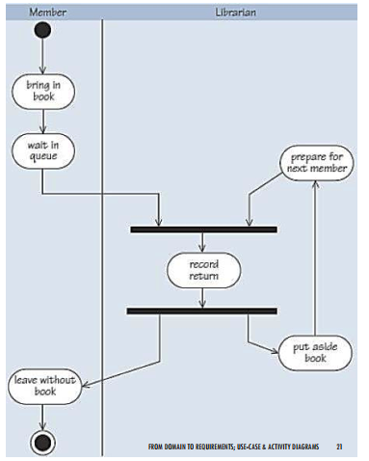
Activity Diagrams: Example (3)
An activity diagram of returning a copy of a book to the library.
Figure 4

Slide 19
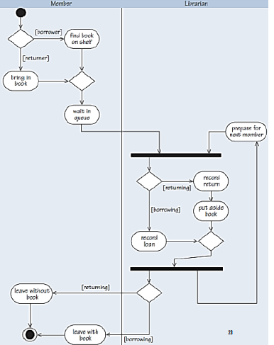
Person
Example (4)
An activity diagram of borrowing and returning a copy of a book.
Figure 5

Slide 20
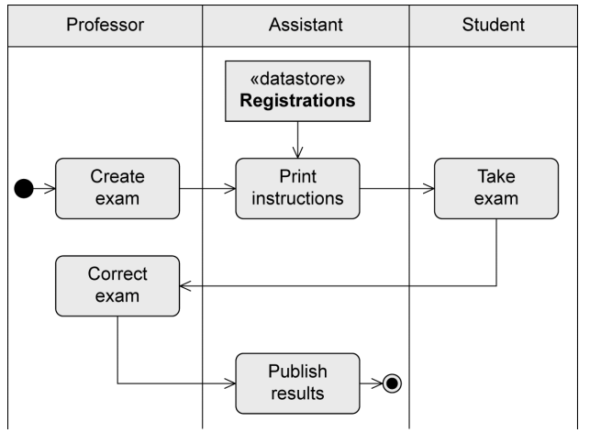
Example (5)
Activity Diagram for process of assessing university students via exams.
Figure 6

Slide 21
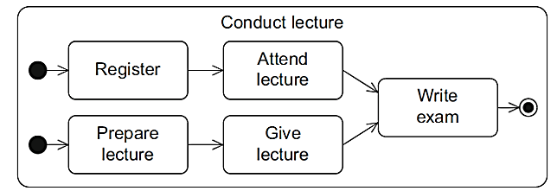
Activity Diagrams: Multiple Initial Nodes
Multiple initial nodes to model concurrency (meaning that multiple execution paths can be active simultaneously).
If the activity Conduct lecture is activated, the two initial nodes and thus both sub paths are activated. One sub path relates to the actions of students and the other sub path refers to the actions performed by a lecturer. In the action Write exam, both paths are merged.

Slide 22
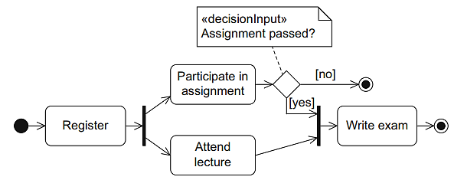
Activity Diagrams: Multiple Final Nodes
If a diagram contains multiple activity final nodes, the first one reached during the execution ends the entire activity.
The participation in a course is ended if either the assignment has not been passed or the exam has been taken.

Slide 23

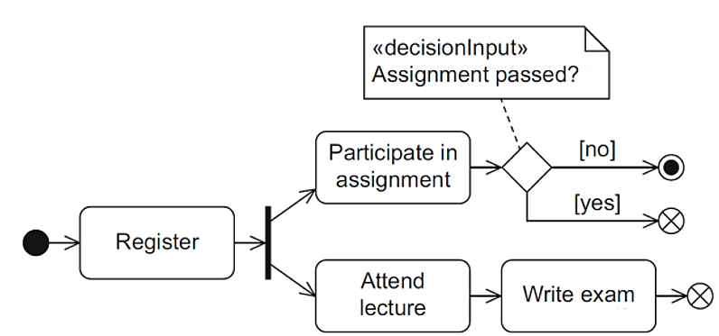
Activity Diagrams: Flow Final Node
If you only want to end one execution path, leaving the other concurrently active execution paths unaffected, you have to use the flow final node.

Slide 24
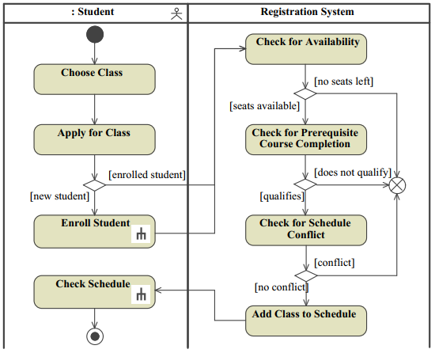
System
An activity diagram of registering a class
Figure 7

Slide 25
State Diagram

Slide 26
Event-Driven Models
Event-driven modelling shows how a system responds to external and internal events.
A system has a finite number of states and that events (stimuli) may cause a transition from one state to another.
The UML supports event-based modelling using State Machine Diagram or State Chart Diagram (state diagrams).
State diagrams show system states and events that cause transitions from one state to another.
They do not show the flow of data within the system.

Slide 27
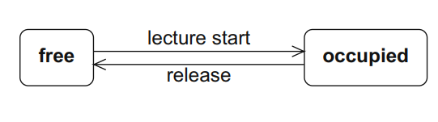
State Diagram: Simple Example
A state diagram represents how a single object changes state over time.
As a simple example consider a lecture hall (object) that can be in one of two states: free or occupied. When a lecture starts in the lecture hall, the state of the lecture hall changes from free to occupied. Once the respective event in the lecture hall has finished and the hall has been released again.
Notes:
understand system behavior from the object’s perspective,

Slide 28
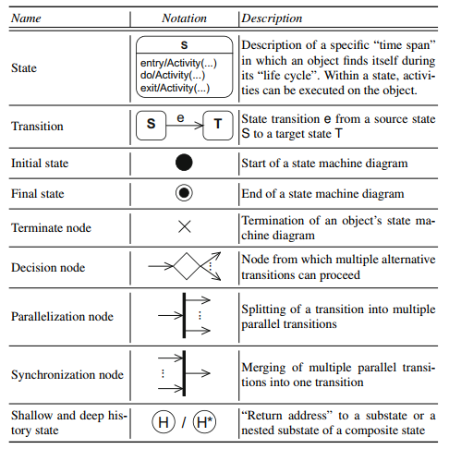
State Diagram Elements

Slide 29
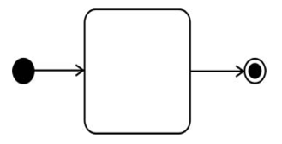
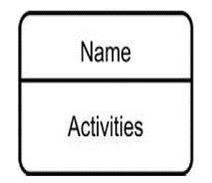
State Diagram
A state is shown as a rectangle with round corners and is labeled with the name of the state.
If internal activities are specified for a state, it is divided into two sections: the upper section contains the name of the state; the lower section includes internal activities.

Slide 30
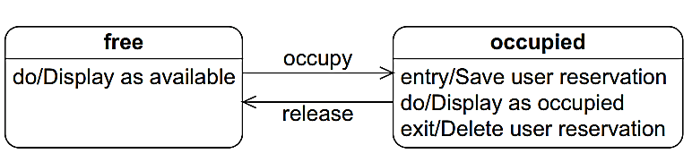
Adding Details to the State Icon
Three frequently used categories of activities :
Entry: What happens when the system enters the state.
Exit: what happens when the system leaves the state.
Do: what happens while the system is in the state.
* Note: You can add others as necessary.

Slide 31
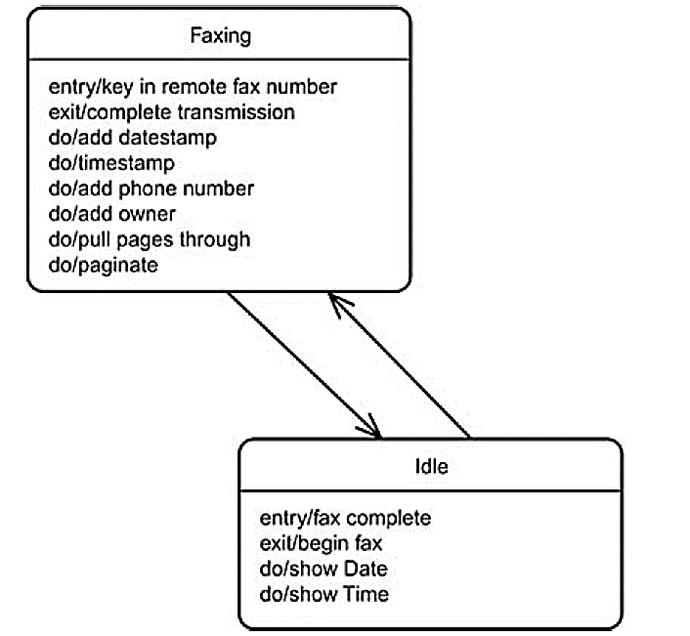
Adding Details to the State Icon
Example (Fax Machine) has 2 states:
Faxing (Sending a fax)
Idle

Slide 32
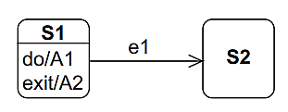
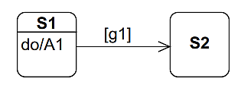
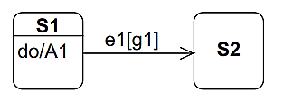
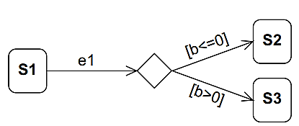
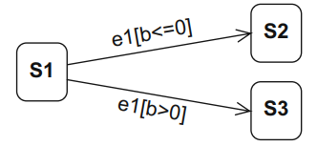
Adding Details to the Transition
You can specify various properties for a transition:
The event (also called “trigger”) that triggers the state transition.
The guard (also called “condition”) that enables the execution of the transition.
Equivalent to
Notes:
e1: If e1 occurs, the execution of the do activity A1 is immediately interrupted and the system switches to state S2. , e1[g1]: guard g1 is checked as soon as e1 occurs. If the guard is true, A1 is terminated and there is a change of state to S2. If the guard is false, event e1 is lost and A1 is not interrupted. ,
[g1]: The system stays in state S1 until A1 is completed. Guard g1 is not checked until this point and the transition takes place if g1 is true. If g1 is false, the system remains in state S1 and it will never be possible to exit S1

Slide 33
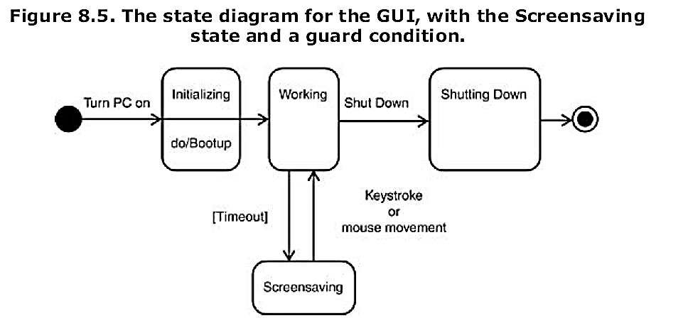
Adding Details to the Transition

Slide 34
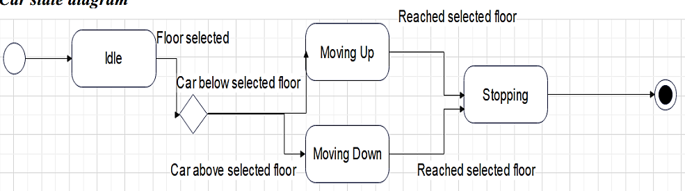
Adding Details to the Transition
* hint: Car is the Elevator

Slide 35
Thank You

